Slide 1

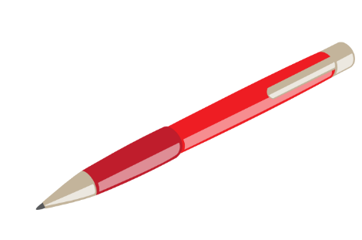



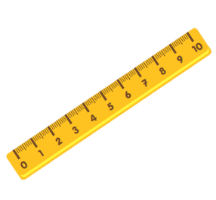
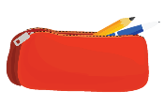
Monday,November 29th,2021
Unit 8:
This is my pen
Lesson 2

Slide 2
VOCABULARY

Slide 3


Vocabulary
rubber /ˈrʌb.ər/
rubbers /ˈrʌb.ərz/

Slide 4
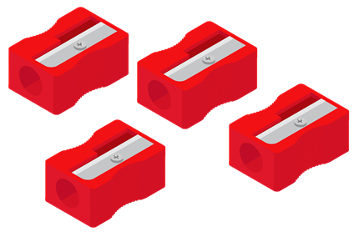
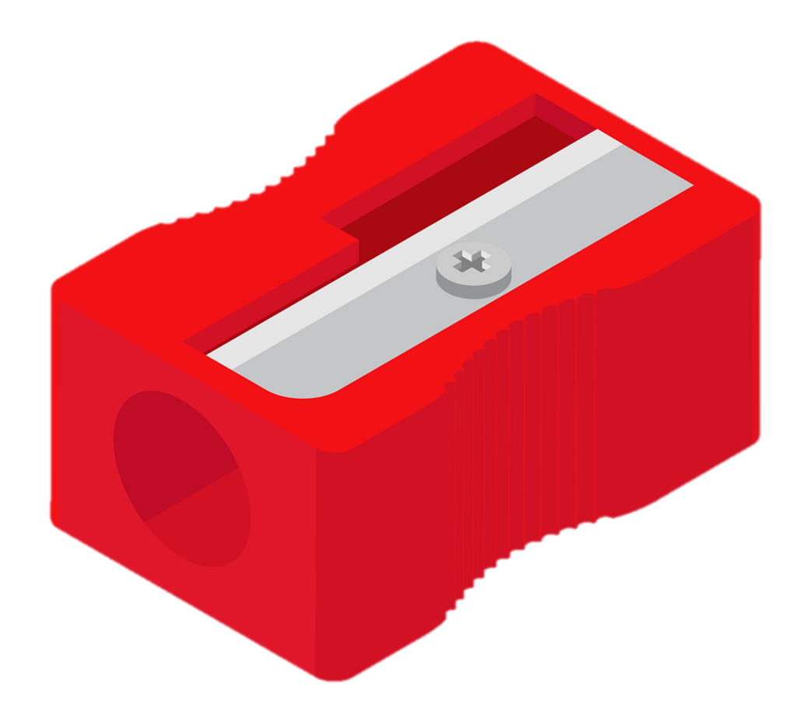
Vocabulary
pencil sharpener
/ˈpensəl ˈʃɑːpənər/
pencil sharpeners
/ˈpensəl ˈʃɑːpənərz/

Slide 5
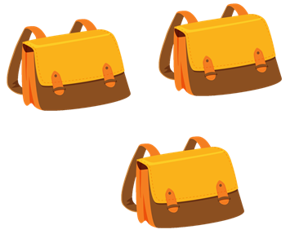

Vocabulary
school bag
/skuːl bæg/
school bags
/skuːl bægz/

Slide 6
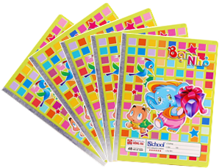
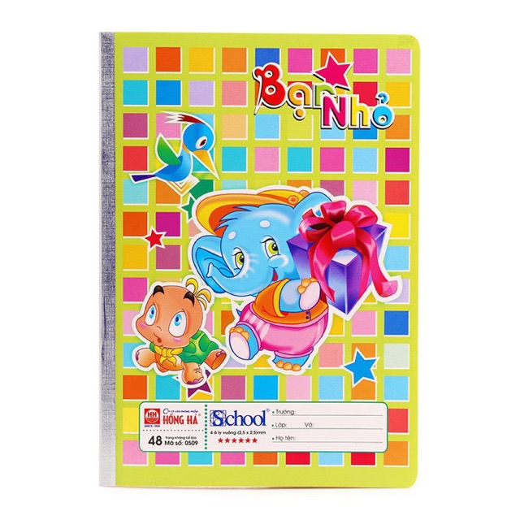
Vocabulary
notebook
/ˈnəʊtbʊk/
notebooks
/ˈnəʊtbʊks/

Slide 7
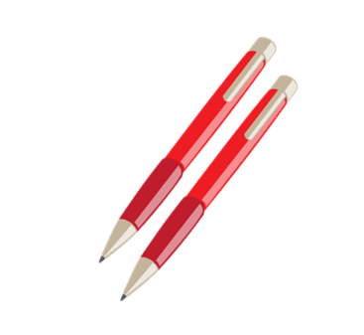

Vocabulary
pen
/pen/
pens
/penz/

Slide 8


Vocabulary
pencils
/ˈpensəlz/
pencils
/ˈpensəlz/

Slide 9
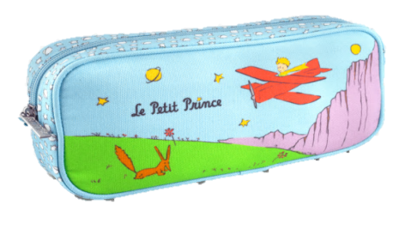


Vocabulary
pencil case
/ˈpensəl ˈkeɪs/
pencil cases
/ˈpensəl ˈkeɪsɪz/

Slide 10
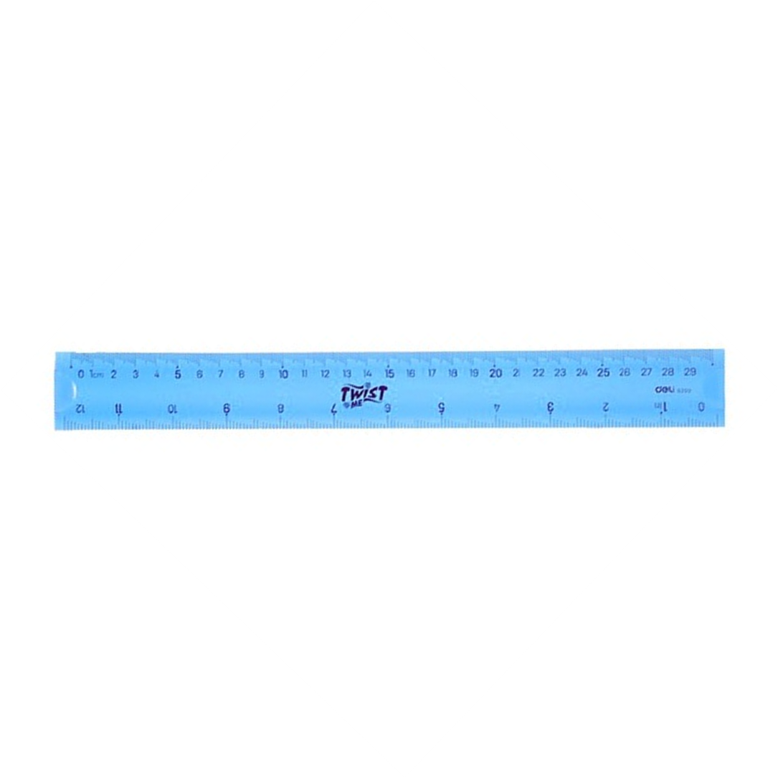
Vocabulary
ruler
/ˈruː.lər/
rulers
/ˈruː.lərz/

Slide 11


Vocabulary
book
/bʊk/
books
/bʊks/

Slide 12
Vocabulary
- These : này (số nhiều)
- Those : kia (số nhiều)
- They : họ,chúng nó

Slide 13
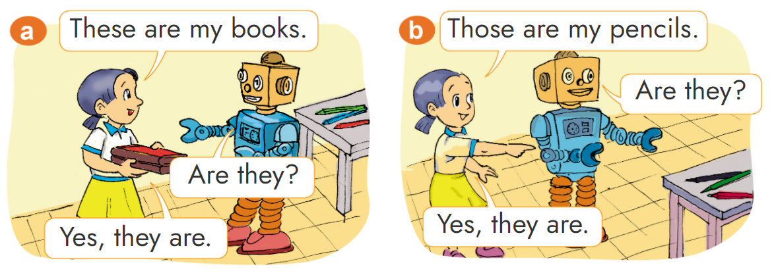

1. Look, listen and repeat.

Slide 14

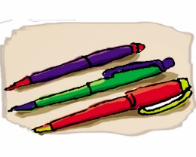
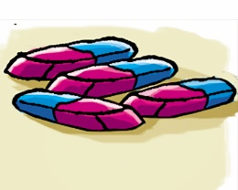
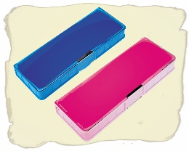

* Sentence Patterns
These are my pencils.
Those are my rulers .

Slide 15
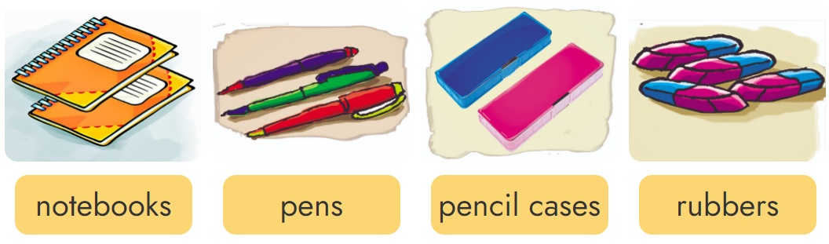
2. Point and say.
These are my _______.

Slide 16
2. Point and say
Those are my _______.

Slide 17
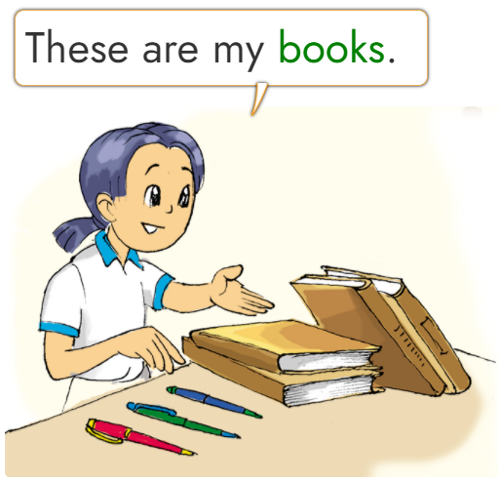
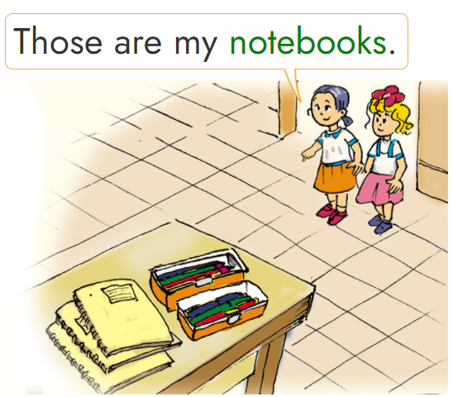
3. Let’s talk
________________.
books
notebooks
pens
pencil cases
_________.
3
1
4
2

Slide 18




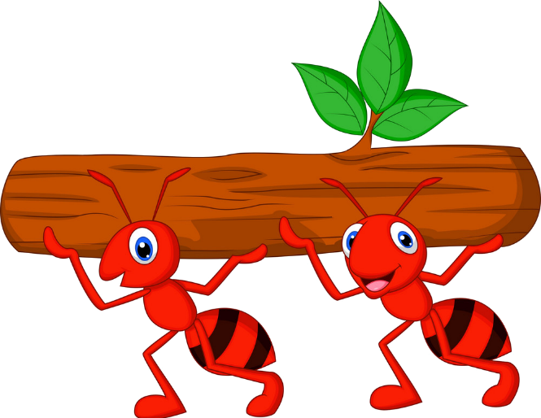



Kiến chăm chỉ
PLAY

Slide 19

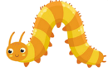


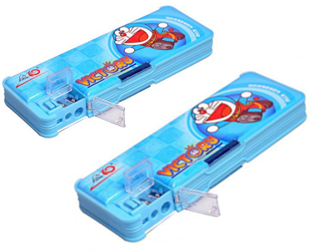




_____ my pencil cases.
Those are
Next
Notes:
Ms Huyền Phạm - 0936.082.789 – YOUTUBE: MsPham. Facebook: Dạy và học cùng công nghệ.

Slide 20

_______ my pencils.
These are
Next
Notes:
Ms Huyền Phạm - 0936.082.789 – YOUTUBE: MsPham. Facebook: Dạy và học cùng công nghệ.

Slide 21
_____ my school bags
These are
Next
Notes:
Ms Huyền Phạm - 0936.082.789 – YOUTUBE: MsPham. Facebook: Dạy và học cùng công nghệ.

Slide 22
____ pencil sharpeners.
Those are
Next
Notes:
Ms Huyền Phạm - 0936.082.789 – YOUTUBE: MsPham. Facebook: Dạy và học cùng công nghệ.

Slide 23
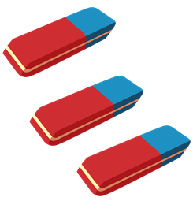
These are my _____.
rubbers
Next
Notes:
Ms Huyền Phạm - 0936.082.789 – YOUTUBE: MsPham. Facebook: Dạy và học cùng công nghệ.

Slide 24
Those are my_____.
notebooks
Next
Notes:
Ms Huyền Phạm - 0936.082.789 – YOUTUBE: MsPham. Facebook: Dạy và học cùng công nghệ.

Slide 25
Those are my_____.
pens
Next
Notes:
Ms Huyền Phạm - 0936.082.789 – YOUTUBE: MsPham. Facebook: Dạy và học cùng công nghệ.

Slide 26
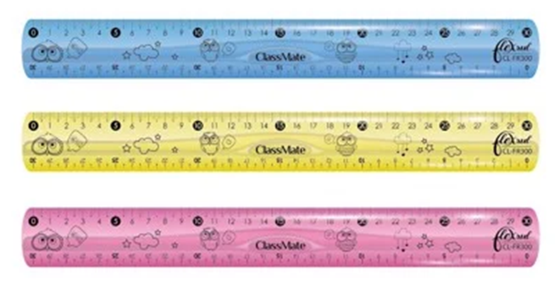
These are my_____.
rulers
Next
Notes:
Ms Huyền Phạm - 0936.082.789 – YOUTUBE: MsPham. Facebook: Dạy và học cùng công nghệ.

Slide 27
Those are my_____.
books
Next
Notes:
Ms Huyền Phạm - 0936.082.789 – YOUTUBE: MsPham. Facebook: Dạy và học cùng công nghệ.

Slide 28
WELL DONE!
EXIT
Notes:
Ms Huyền Phạm - 0936.082.789 – YOUTUBE: MsPham. Facebook: Dạy và học cùng công nghệ.

Slide 29
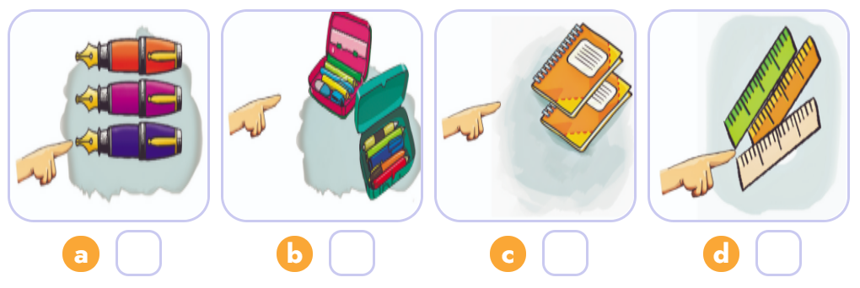
4. Listen and number.
3
4
2
1
1
2
3
4

Slide 30
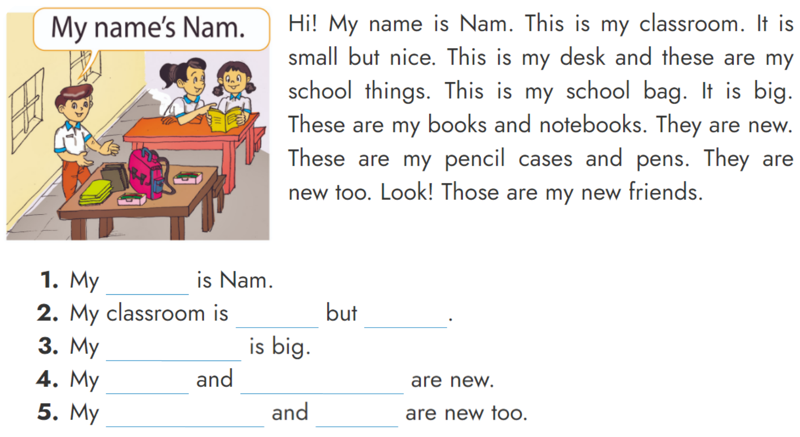
5. Read and write.
name
small
nice
school bag
books
notebooks
pencil cases
pens

Slide 31
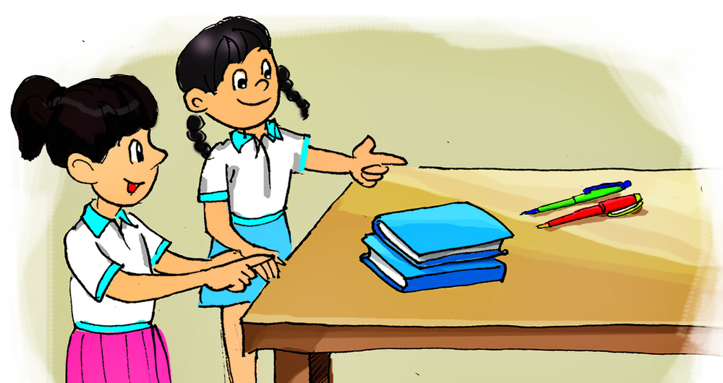
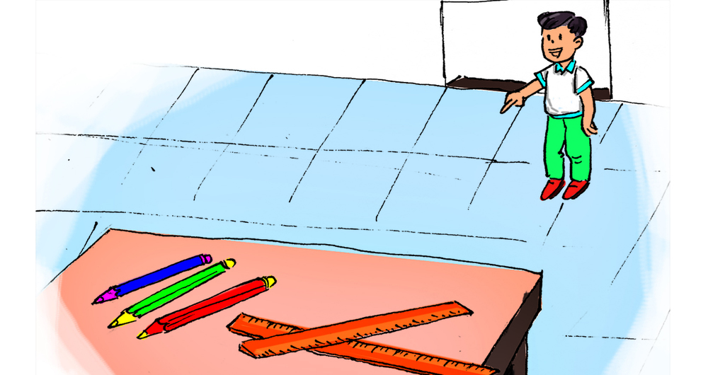
6. Let's write.
are
2. Those ___ my ______ _____ and ___________.
pencils
1. These _____ my _____ ______ and __________.
are
pens
/
rulers
rulers
/
/
pencils
books
books
pens
/

Slide 32




The bye bye song
Bye, bye.
See you tomorrow.
Bye, bye.
See you tomorrow.
Bye, bye.
See you tomorrow.
Bye, bye. Bye, bye.
The bye bye song

